Slide 1


MIT School of Computing Department of Computer Science & Engineering
Second Year Engineering
Database Management System
(23CSE2022) Class - S.Y.
PLD
AY 2026-2027
SEM-I

Slide 2
MIT School of Computing Department of Computer Science & Engineering
Database Management System
Teaching Scheme | Credit Scheme | Examination Scheme and Marks
Lecture: 03 Hours/Week | 03 | Continues Assessment (TH): 50 Marks End_Semester_Examination (TH): 50 Marks
PLD

Slide 3
Unit – I
Introduction to Database Management Systems

Slide 4
MIT School of Computing Department of Computer Science & Engineering
Syllabus
Database system, purpose of database system,
view of data, relational databases, database architecture,
Database Concepts,
Three-schema architecture of a database, Data Models,
ER model, Relational Model, ER to Table Conversion
PLD

Slide 5
MIT School of Computing Department of Computer Science & Engineering
Introduction :
Database
A collection of related data that is stored in a central location or in multiple locations
A database is a structured collection of data.
Data hierarchy: Structure and organization of data involving fields, records, and files
Database Management System (DBMS)
Software for creating, storing, maintaining, and accessing database files
Makes using databases more efficient
PLD

Slide 6
Database Applications Examples
Enterprise Information
• Sales: customers, products, purchases
• Accounting: payments, receipts, assets
• Human Resources: Information about employees,
salaries, payroll taxes.
Manufacturing: management of production, inventory, orders, supply chain.
Banking and finance
• customer information, accounts, loans, and banking
transactions.
• Credit card transactions

Slide 7
Database Applications Examples
Universities: registration, grades
Airlines: reservations, schedules
Telecommunication: records of calls, texts, and data usage, generating monthly bills, maintaining balances on prepaid calling cards
Web-based services
• Online retailers: order tracking, customized recommendations
• Online advertisements

Slide 8
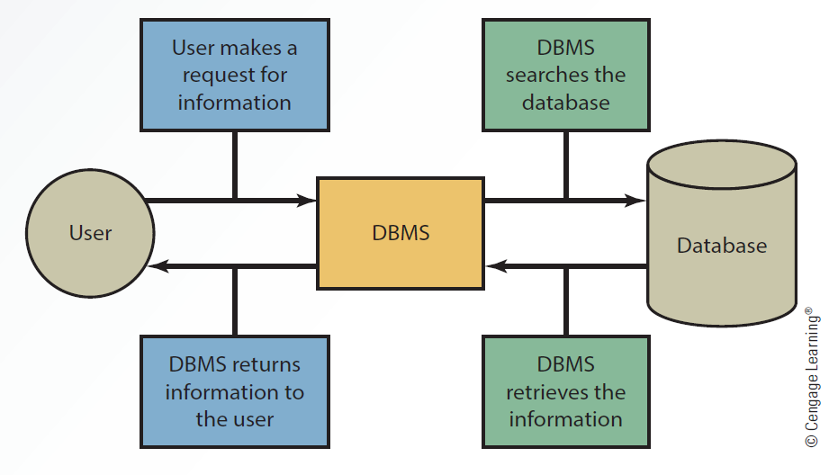
Interaction Between the User, DBMS and Database

Slide 9
Interaction Between the User, DBMS and Database
Working of a DBMS (Database Management System)
User makes a request The user asks for information by entering a query or request.
Request goes to the DBMS The DBMS receives the user's request and processes it.
DBMS searches the database The DBMS checks the database to find the required data.
DBMS retrieves the information After finding the matching data, the DBMS collects the required information from the database.
DBMS returns the information to the user Finally, the DBMS sends the retrieved information back to the user in an easy-to-understand format.

Slide 10
Purpose of Database Systems/ Disadvantage of File-oriented system
Data Redundancy:
It is possible that the same information may be duplicated in different files. this leads to data redundancy results in memory wastage.
Data Inconsistency:
Because of data redundancy, it is possible that data may not be in consistent state.
Limited Data Sharing:
Data are scattered in various files. Also different files may have different formats and these files may be stored in different folders may be of different departments.
So, due to this data isolation, it is difficult to share data among different applications.

Slide 11
Integrity Problems:
Data integrity means that the data contained in the database in both correct and consistent. for this purpose the data stored in database must satisfy correct and constraints.
Eg. If a user enters a mobile number in the incorrect format.
If the user attempts to remove a record from a database, however, that record is referenced in another table as a relationship
Difficulty in Accessing Data:
Accessing data is not convenient and efficient in file processing system.
Atomicity Problems:
Any operation on database must be atomic.
this means, it must happen in its entirely or not at all.

Slide 12
Concurrent Access Anomalies:
Multiple users are allowed to access data simultaneously. this is for the sake of better performance and faster response.
Security Problems:
Database should be accessible to users in limited way.
Each user should be allowed to access data concerning his requirements only

Slide 13
View of Data
A database system is a collection of interrelated data and a set of programs that allow users to access and modify these data.
A major purpose of a database system is to provide users with an abstract view of the data. That is, the system hides certain details of how the data are stored and maintained.
Data Abstraction
Instances and Schemas
Data Models

Slide 14
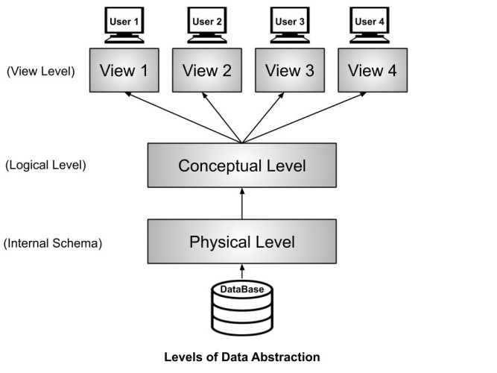
Data Abstraction
There are mainly three levels of data abstraction:
Internal Level: Actual PHYSICAL storage structure and access paths.
Conceptual or Logical Level: Structure and constraints for the entire database
External or View level: Describes various user views

Slide 15
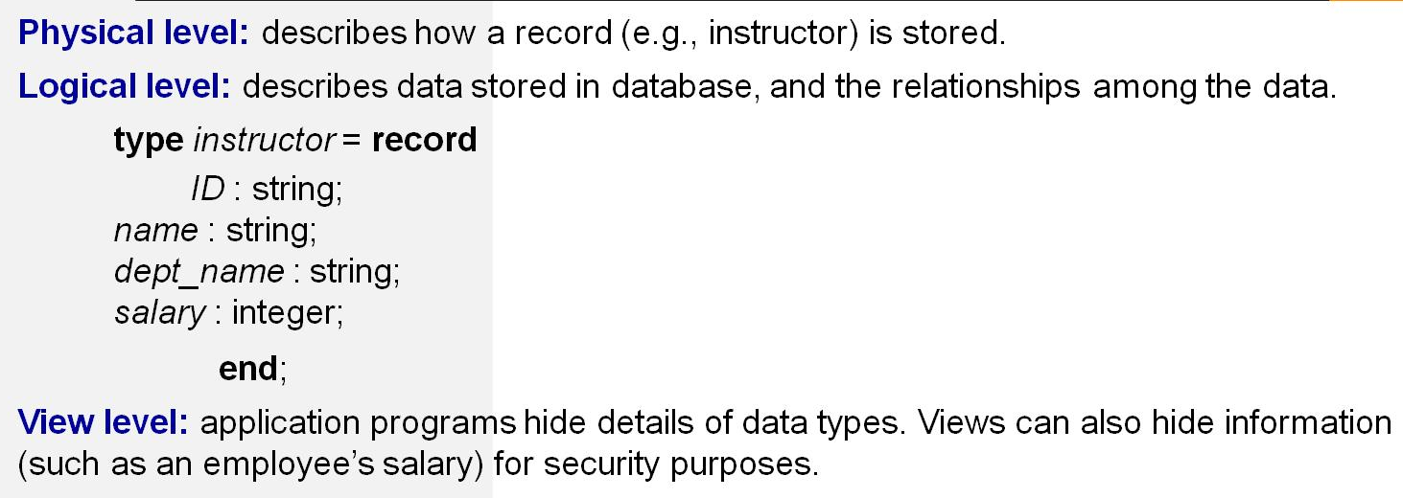
Example: Let’s say we are storing customer information in a customer table. At physical level these records can be described as blocks of storage (bytes, gigabytes, terabytes etc.) in memory. These details are often hidden from the programmers.
Gmail account

Slide 16
Instance:
The collection of information stored in the database at a particular moment is called an instance of the database.
Schemas: The Overall Structure of a database is called Schemas
Logical Schema :logical structure of DB
Example- Customers Acc
Physical Schema: Physical structure of DB
Example- Files

Slide 17
Data Independence
Logical Data Independence :Ability to modify the logical schema without affecting the external schema/application program
Physical Data Independence
Ability to modify the physical schema without changing the logical schema.
Applications depend on the logical schema
In general, the interfaces between the various levels and components should be well defined so that changes in some parts do not seriously influence others.

Slide 18
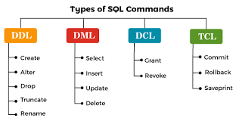

Slide 19
Relational Databases
A relational database is based on the relational model and uses a collection of tables to represent both data and the relationships among those data.
Tables
Data-Manipulation Language
Data-Definition Language

Slide 20
Data-Definition Language
Specification notation for defining the database schema
Example: create table instructor (
ID char(5),
name varchar(20),
dept_name varchar(20),
salary numeric(8,2))
DDL compiler generates a set of table templates stored in a data dictionary
Data dictionary contains metadata (i.e., data about data)

Slide 21
DDL Command
ALTER:
ALTER TABLE table_name ADD column_name datatype;
TRUNCATE:
TRUNCATE TABLE table_name;
CREATE:
CREATE TABLE table_name ( column1 datatype, column2 datatype, column3 datatype, .... );
DROP:
DROP TABLE table_name;

Slide 22
Create
Step 1:
>SHOW DATABASES;
+--------------------+
| Database |
+--------------------+
| CollegeDB |
| information_schema |
| mysql |
| performance_schema |
| sys |
+--------------------+

Slide 23
Step 2:
-- Create a database
>CREATE DATABASE CollegeDB;
-- Select the database
>USE CollegeDB;
-- Create a table
>CREATE TABLE Student (
StudentID INT PRIMARY KEY,
StudentName VARCHAR(50),
Age INT,
Department VARCHAR(30)
);
-- Display all databases
>SHOW DATABASES;
-- Display all tables
>SHOW TABLES;
--Display the Table
>DESC Student;

Slide 24
Output:
+-------------+-------------+------+-----+---------+-------+
| Field | Type | Null | Key | Default | Extra |
+-------------+-------------+------+-----+---------+-------+
| StudentID | int | NO | PRI | NULL | |
| StudentName | varchar(50) | YES | | NULL | |
| Age | int | YES | | NULL | |
| Department | varchar(30) | YES | | NULL | |
+-------------+-------------+------+-----+---------+-------+

Slide 25
Alter:
Add a Phone column to the Student table.
>ALTER TABLE Student
ADD PhoneNumber VARCHAR(15);
>DESC Student;
+-------------+-------------+------+-----+---------+-------+
| Field | Type | Null | Key | Default | Extra |
+-------------+-------------+------+-----+---------+-------+
| StudentID | int | NO | PRI | NULL | |
| StudentName | varchar(50) | YES | | NULL | |
| Age | int | YES | | NULL | |
| Department | varchar(30) | YES | | NULL | |
| PhoneNumber | varchar(15) | YES | | NULL | |
+-------------+-------------+------+-----+---------+-------+

Slide 26
Mysql>ALTER TABLE table_name
-> DROP COLUMN column_name_1,
-> DROP COLUMN column_name_2,
-> ;
mysql> alter table students drop column phonenumber;
mysql> desc students;
+------------+-------------+------+-----+---------+-------+
| Field | Type | Null | Key | Default | Extra |
+------------+-------------+------+-----+---------+-------+
| st_roll_no | int | YES | | NULL | |
| st_name | varchar(10) | YES | | NULL | |
| st_address | varchar(10) | YES | | NULL | |
+------------+-------------+------+-----+---------+-------+
3 rows in set (0.00 sec)

Slide 27
mysql> alter table students rename to student_info;
mysql> desc students;
ERROR 1146 (42S02): Table 'ddl.students' doesn't exist
mysql> desc students_info;
+------------+-------------+------+-----+---------+-------+
| Field | Type | Null | Key | Default | Extra |
+------------+-------------+------+-----+---------+-------+
| st_roll_no | int | YES | | NULL | |
| st_name | varchar(10) | YES | | NULL | |
| st_address | varchar(10) | YES | | NULL | |
+------------+-------------+------+-----+---------+-------+

Slide 28
mysql> alter table student_info rename column st_address to st_pincode;
mysql> desc student_info;
+------------+-------------+------+-----+---------+-------+
| Field | Type | Null | Key | Default | Extra |
+------------+-------------+------+-----+---------+-------+
| st_roll_no | int | YES | | NULL | |
| st_name | varchar(10) | YES | | NULL | |
| st_pincode | varchar(10) | YES | | NULL | |

Slide 29
Truncate:
.
The TRUNCATE command deletes all records from the table but keeps the table structure
mysql> truncate table student_info;
mysql> desc student_info;
+------------+-------------+------+-----+---------+-------+
| Field | Type | Null | Key | Default | Extra |
+------------+-------------+------+-----+---------+-------+
| st_roll_no | int | YES | | NULL | |
| st_name | varchar(10) | YES | | NULL | |
| st_pincode | varchar(10) | YES | | NULL | |
+------------+-------------+------+-----+---------+-------+

Slide 30
Drop:
mysql> drop table student_info;
Query OK, 0 rows affected (0.02 sec)
mysql> desc student_info;
ERROR 1146 (42S02): Table 'ddl.student_info' doesn't exist

Slide 31
Data-Manipulation Language
There are basically two types of data-manipulation language
Procedural DML -- require a user to specify what data are
needed and how to get those data.
Declarative DML -- require a user to specify what data are needed without specifying how to get those data.
Declarative DMLs are usually easier to learn and use than are procedural DMLs.
Declarative DMLs are also referred to as non-procedural DMLs
The portion of a DML that involves information retrieval is called a query language.

Slide 32
Procedural DML
A language in which the user specifies both what data is required and how to retrieve it. The programmer writes the steps for data retrieval.
Example: PL/SQL, Embedded SQL
Open Student table
Read each record
If Marks > 80
Display Name
End

Slide 33
Non-Procedural DML:
A language in which the user specifies only what data is required, while the DBMS determines how to retrieve it.
Example:SQL(Select, Update,Insert, Delete)
SELECT Name
FROM Student
WHERE Marks > 80;

Slide 34
DML
DML is short name of Data Manipulation Language which deals with data manipulation.
SELECT - retrieve data from a database
INSERT - insert data into a table
UPDATE - updates existing data within a table
DELETE - Delete all records from a database table

Slide 35
DML Command
INSERT:
Examples:
SELECT:
Example:
Insert into <table_name> (column list) values (column values);
Insert into Employee(Emp_id, Emp_name) values (001, “ bhanu”);
Insert into Employee(Emp_id, Emp_name) values (002, “ hari”);
Insert into Employee(Emp_id, Emp_name) values (003, “ bob”);
SELECT * from <table_name>;
SELECT * from Employee;

Slide 36
DELETE:
Examples:
UPDATE:
Examples
Delete from <table_name>WHERE condition;
DELETE from Employee WHERE Emp_id=002;
UPDATE <table_name> SET column_number =value_number WHERE condition;
UPDATE Employee SET Emp_name= Ram WHERE Emp_id= 001;

Slide 37
Database Architecture
Centralized databases
One to a few cores, shared memory
Client-server,
One server machine executes work on behalf of multiple client machines.
Parallel databases
Many core shared memory
Shared disk
Shared nothing
Distributed databases
Geographical distribution
Schema/data heterogeneity

Slide 38
Database Architecture
The architecture of a database system is greatly influenced by the underlying computer system on which the database system runs.
Database systems can be centralized, or client-server, where one server machine executes work on behalf of multiple client machines.
A database system is partitioned into modules that deal with each of the responsibilities of the overall system.
The functional components of a database system can be divided into
The storage manager,
The query processor component,
The transaction management component

Slide 39
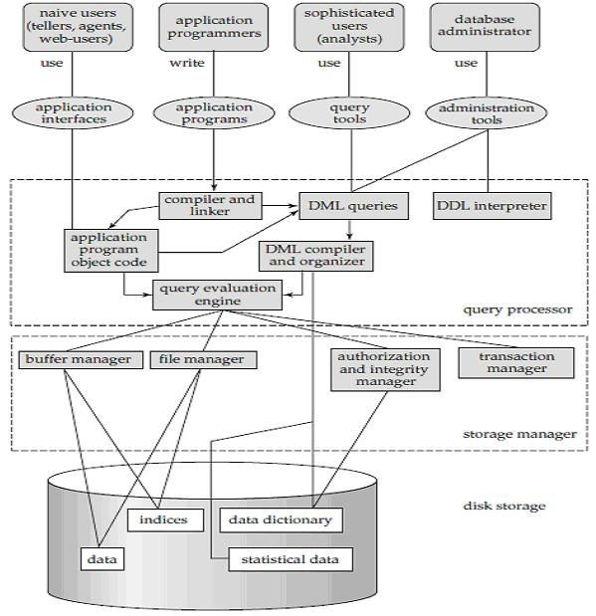
Database Architecture

Slide 40
The Query Processor
The query processor components include
• DDL interpreter, which interprets DDL statements and records the definitions in the data dictionary.
• DML compiler, which translates DML statements in a query language into an evaluation plan consisting of low-level instructions that the query evaluation engine understands.
A query can usually be translated into any of a number of alternative evaluation plans that all give the same result. The DML compiler also performs query optimization, that is, it picks the lowest cost evaluation plan from among the alternatives.
• Query evaluation engine, which executes low-level instructions generated by the DML compiler.

Slide 41
Storage Manager
A storage manager is a program module that provides the interface between the low level data stored in the database and the application programs and queries submitted to the system.
The storage manager is responsible for the interaction with the file manager.
The raw data are stored on the disk using the file system, which is usually provided by a conventional operating system. The storage manager translates the various DML statements into low-level file-system commands.
Thus, the storage manager is responsible for storing, retrieving, and updating data in the database.

Slide 42
The storage manager components include:
Authorization and integrity manager, which tests for the satisfaction of integrity constraints and checks the authority of users to access data.
Transaction manager, which ensures that the database remains in a consistent (correct) state despite system failures, and that concurrent transaction executions proceed without conflicting.
File manager, which manages the allocation of space on disk storage and the data structures used to represent information stored on disk.
Buffer manager, which is responsible for fetching data from disk storage into main memory, and deciding what data to cache in main memory.

Slide 43
The storage manager implements several data structures as part of the physical system implementation:
Data files, which store the database itself.
Data dictionary, which stores metadata about the structure of the database, in particular the schema of the database.
Indices, which provide fast access to data items that hold particular values

Slide 44
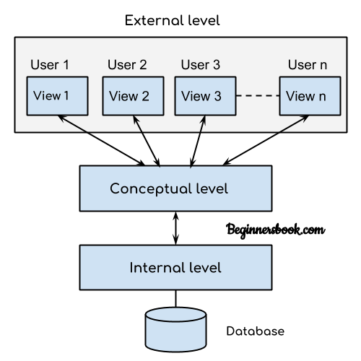
DBMS Three Level Architecture
This architecture has three levels: 1. External level 2. Conceptual level 3. Internal level

Slide 45
1. External level
It is also called view level. The reason this level is called “view” is because several users can view their desired data from this level which is internally fetched from database with the help of conceptual and internal level mapping.
2. Conceptual level
It is also called logical level. The whole design of the database such as relationship among data, schema of data etc. are described in this level.
3. Internal level
This level is also known as physical level. This level describes how the data is actually stored in the storage devices. This level is also responsible for allocating space to the data. This is the lowest level of the architecture.

Slide 46
Data Models
data model: a collection of conceptual tools for describing data, data relationships, data semantics, and consistency constraints
Data Model gives us an idea that how the final system will look like after its complete implementation.
Data Models are used to show how data is stored, connected, accessed and updated in the database management system.
Data models define how the logical structure of a database is modeled.
It is classified into 3 types:
Conceptual Data Models -- ER Model
Representational Data Models – Relational Model
Physical Data Models

Slide 47
Entity-Relationship Model
ER model stands for an Entity-Relationship model. It is a high-level data model. This model is used to define the data elements and relationship for a specified system.
It develops a conceptual design for the database.
We use the ER diagram as a visual tool to represent an ER Model. ER diagram has the following three components:
Entities: Entity is a real-world thing. It can be a person, place, or even a concept. Example: Teachers, Students, Course, Building, Department, etc. are some of the entities of a School Management System.
Attributes: An entity contains a real-world property called attribute. This is the characteristics of that attribute. Example: The entity teacher has the property like teacher id, salary, age, etc.
Relationship: Relationship tells how two entities are related. Example: Teacher works for a department.

Slide 48

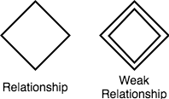



Entity-Simple rectangular box represents an Entity.
Relationships between Entities - Weak and Strong
Weak Entity-A weak Entity is represented using double rectangular boxes
Derived Attribute for any Entity
Multivalued Attribute for any Entity

Slide 49
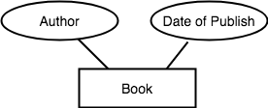
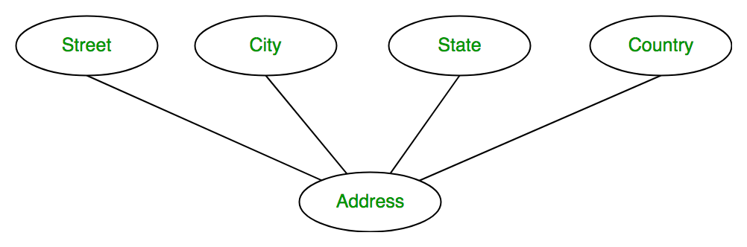
Attributes for any Entity
Composite Attribute for any Entity

Slide 50
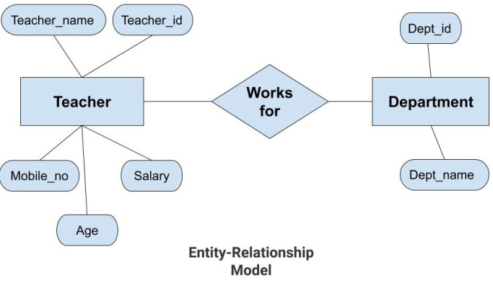

Slide 51
Advantages of ER Model
Simple: Conceptually ER Model is very easy to build. If we know the relationship between the attributes and the entities we can easily build the ER Diagram for the model.
Effective Communication Tool: This model is used widely by the database designers for communicating their ideas.
Easy Conversion to any Model: This model maps well to the relational model and can be easily converted relational model by converting the ER model to the table. This model can also be converted to any other model like network model, hierarchical model etc.

Slide 52
Types of Entity type
Strong Entity Type
Weak Entity Type
Strong Entity Type: Strong entity are those entity types which has a key attribute. The primary key helps in identifying each entity uniquely
Weak Entity Type: Weak entity type doesn't have a key attribute. Weak entity type can't be identified on its own. It depends upon some other strong entity for its distinct identity.

Slide 53
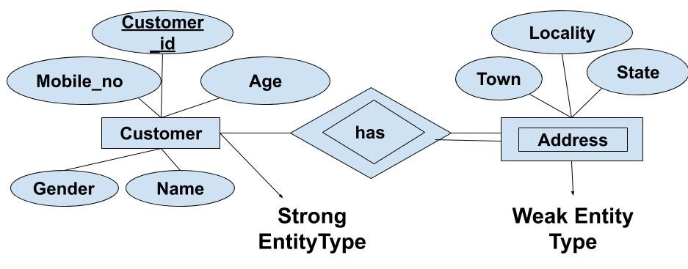
If we have two tables of Customer and Address.
Here we cannot identify the address uniquely as there can be many customers from the same locality.
So, for this, we need an attribute of Strong Entity Type i.e ‘Customer’ here to uniquely identify entities of 'Address' Entity Type.

Slide 54
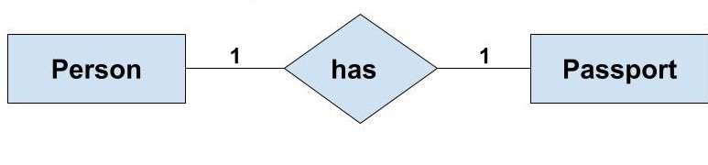
Relationship in DBMS
Any association between two entity types is called a relationship.
One-to-One Relationship
One-to-Many or Many-to-One Relationship
Many-to-Many Relationship
One-to-One Relationship
Such a relationship exists when each record of one table is related to only one record of the other table.

Slide 55
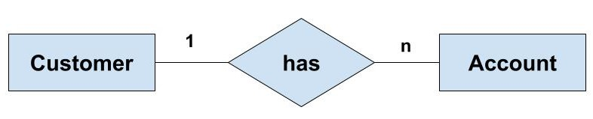
One-to-Many or Many-to-One Relationship
Such a relationship exists when each record of one table can be related to one or more than one record of the other table
If there are two entity type ‘Customer’ and ‘Account’ then each ‘Customer’ can have more than one ‘Account’ but each ‘Account’ is held by only one ‘Customer’. In this example, we can say that each Customer is associated with many Account. So, it is a one-to-many relationship. But, if we see it the other way i.e many Account is associated with one Customer then we can say that it is a many-to-one relationship.

Slide 56
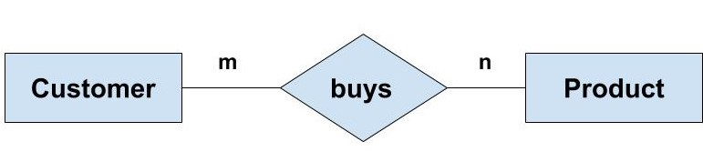
Many-to-Many Relationship
If there are two entity type ‘Customer’ and ‘Product’ then each customer can buy more than one product and a product can be bought by many different customers.

Slide 57

Types of Participation Constraints-
Total participation
Partial participation
1. Total Participation-
It specifies that each entity in the entity set must compulsorily participate in at least one relationship instance in that relationship set.
That is why, it is also called as mandatory participation.
Total participation is represented using a double line between the entity set and relationship set.
Double line between the entity set “Student” and relationship set “Enrolled in” signifies total participation.
It specifies that each student must be enrolled in at least one course.

Slide 58
2. Partial Participation-
It specifies that each entity in the entity set may or may not participate in the relationship instance in that relationship set.
That is why, it is also called as optional participation.
Partial participation is represented using a single line between the entity set and relationship set.
Single line between the entity set “Course” and relationship set “Enrolled in” signifies partial participation.
It specifies that there might exist some courses for which no enrollments are made.

Slide 59
Types of Attributes-
Simple attributes
Composite attributes
Single valued attributes
Multi valued attributes
Derived attributes
Key attributes

Slide 60
Types of Attributes-
Simple attributes :
Cannot be divided into smaller parts. It stores a single piece of information.
Example: Age, Gender, Salary.
Composite attributes :
Can be divided into smaller sub-attributes.
Example: Name → First Name, Middle Name, Last Name. Address → House No., Street, City, State, PIN Code.
Single valued attributes : Has only one value for each entity.
Example: Roll Number, Date of Birth, Aadhaar Number.

Slide 61
Types of Attributes-
Multi valued attributes: Can have multiple values for a single entity.
Example: Phone Numbers, Email IDs, Skills.
Derived attributes: Its value is calculated from another attribute.
It is usually not stored in the database.
Example: Age is derived from Date of Birth.
Key attributes: Uniquely identifies each record in an entity. No two records can have the same key value.
Example: Student ID, Employee ID, Roll Number.

Slide 62
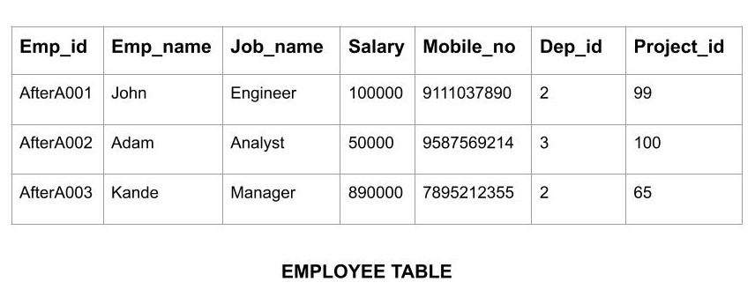
Relational Model
Relational Model is the most widely used model.
In this model, the data is maintained in the form of a two-dimensional table.
All the information is stored in the form of row and columns. The basic structure of a relational model is tables.

Slide 63
ER to Table conversion
Entity type becomes a table.
All single-valued attribute becomes a column for the table.
A key attribute of the entity type represented by the primary key.
Composite attribute represented by components.(student address is a composite attribute, It contains CITY, PIN, DOOR#, STREET, and STATE, In the STUDENT table, these attributes can merge as an individual column.)
Derived attributes are not considered in the table.

Slide 64
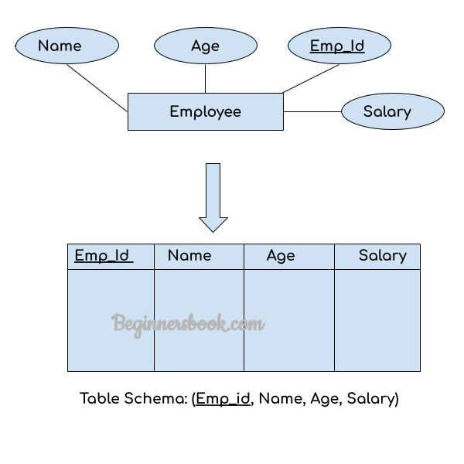

Slide 65
Relationship Set to Table conversion
While converting the relationship set to a table, the primary attributes of the two entity sets becomes the table attributes and if the relationship set has any attribute that also becomes the attribute of the table.
For example :we have two entity sets Employee and Department. These entity sets are associated to each other using the Works relationship set. To convert this relationship set Works to the table, we take the primary attributes of each entity set, these are Emp_Id and Dept_Id and all the attributes of the relationship set and form a table.

Slide 66
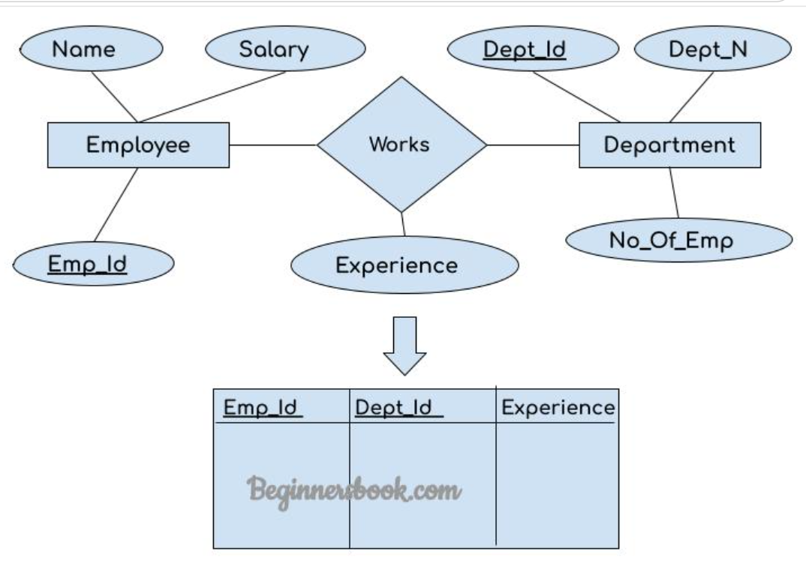

Slide 67
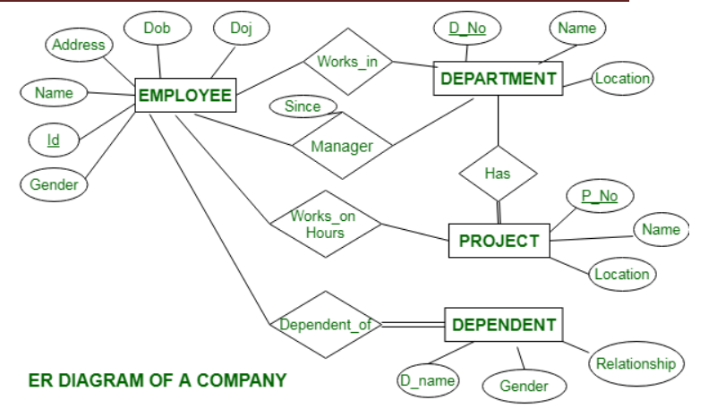

Slide 68
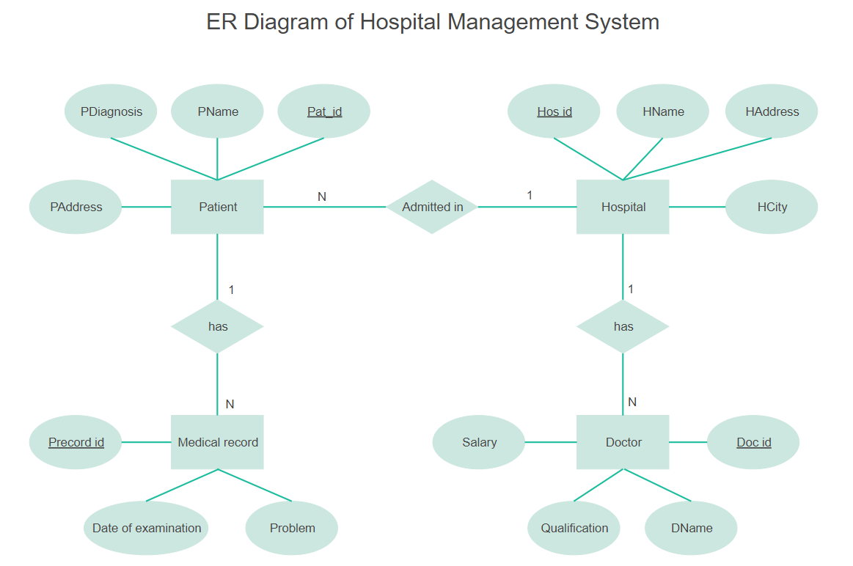

Slide 69
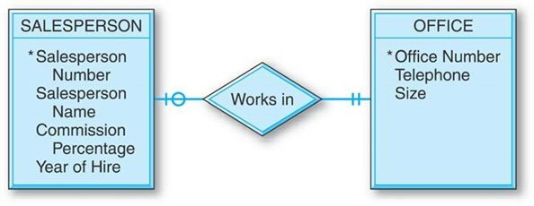
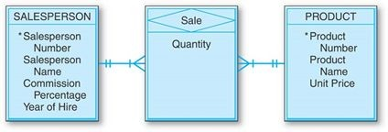

Slide 70
SQL Characteristics and advantages
SQL stands for Structured Query Language
SQL lets you access and manipulate databases
SQL is a database language designed for the retrieval and management of data in a relational database.
SQL is the standard language for database management
All the RDBMS systems like MySQL, MS Access, Oracle, Sybase, Postgres, and SQL Server use SQL as their standard database language.
SQL programming language uses various commands for different operations like DCL, TCL, DQL, DDL and DML.

Slide 71
SQL Data types SQL Server String Data Type
char(n) | It is a fixed width character string data type. Its size can be up to 8000 characters.
varchar(n) | It is a variable width character string data type. Its size can be up to 8000 characters.
varchar(max) | It is a variable width character string data types. Its size can be up to 1,073,741,824 characters.
text | It is a variable width character string data type. Its size can be up to 2GB of text data.
nchar | It is a fixed width Unicode string data type. Its size can be up to 4000 characters.
nvarchar | It is a variable width Unicode string data type. Its size can be up to 4000 characters.

Slide 72
MySQL Date and Time Data Types
DATE | It is used to specify date format YYYY-MM-DD. Its supported range is from '1000-01-01' to '9999-12-31'.
DATETIME(fsp) | It is used to specify date and time combination. Its format is YYYY-MM-DD hh:mm:ss. Its supported range is from '1000-01-01 00:00:00' to 9999-12-31 23:59:59'.
TIMESTAMP(fsp) | It is used to specify the timestamp. Its value is stored as the number of seconds since the Unix epoch('1970-01-01 00:00:00' UTC). Its format is YYYY-MM-DD hh:mm:ss. Its supported range is from '1970-01-01 00:00:01' UTC to '2038-01-09 03:14:07' UTC.
TIME(fsp) | It is used to specify the time format. Its format is hh:mm:ss. Its supported range is from '-838:59:59' to '838:59:59'
YEAR | It is used to specify a year in four-digit format. Values allowed in four digit format from 1901 to 2155, and 0000.

Slide 73
MySQL Numeric Data Types
BIT(Size) | It is used for a bit-value type. The number of bits per value is specified in size. Its size can be 1 to 64. The default value is 1.
INT(size) | It is used for the integer value. Its signed range varies from -2147483648 to 2147483647 and unsigned range varies from 0 to 4294967295. The size parameter specifies the max display width that is 255.
INTEGER(size) | It is equal to INT(size).
FLOAT(size, d) | It is used to specify a floating point number. Its size parameter specifies the total number of digits. The number of digits after the decimal point is specified by d parameter.
FLOAT(p) | It is used to specify a floating point number. MySQL used p parameter to determine whether to use FLOAT or DOUBLE. If p is between 0 to24, the data type becomes FLOAT (). If p is from 25 to 53, the data type becomes DOUBLE().
DOUBLE(size, d) | It is a normal size floating point number. Its size parameter specifies the total number of digits. The number of digits after the decimal is specified by d parameter.

